Slide 1
Employee Retention Prediction
Machine Learning Project

Slide 2
Project Overview
Project Goal: Predict whether a data scientist is likely to look for a job change using machine learning.
Why this project is important:
Helps companies identify employees who may leave
Supports HR in improving retention strategies
Enables proactive recruitment planning
Helps allocate training and development resources effectively
What this project includes:
Exploratory Data Analysis (EDA)
Data preprocessing and feature engineering
Multiple ML models (Logistic Regression, Random Forest, XGBoost, LightGBM)
Model comparison using accuracy & ROC‑AUC
Final model deployment using Streamlit

Slide 3
Business Problem
Employee attrition is a major challenge for companies. Replacing skilled employees—especially data scientists—is expensive and time‑consuming.
Key problems faced by companies:
Sudden resignations disrupt ongoing projects
Hiring new data scientists requires high cost and long onboarding time
HR teams struggle to identify employees who may leave
Lack of early warning leads to poor workforce planning
Productivity drops when experienced employees quit
Why prediction is needed:
To identify employees with high job‑change probability
To take proactive retention actions
To reduce hiring costs
To improve workforce stability

Slide 4
Dataset Description
Total Records
Training Data: 19,158 rows
Test Data: 2129 rows
Key Features
city: Employee’s city
city_development_index: Development score of the city (0–1)
gender: Male / Female / Other
relevent_experience: Has relevant experience or not
enrolled_university: Full‑time / Part‑time / No enrollment
education_level: Graduate / Masters / PhD / etc.
major_discipline: STEM / Business / Arts / Humanities
experience: Total years of experience
company_size: Size of current company
company_type: Type of company (Pvt Ltd, Startup, NGO, etc.)
last_new_job: Years since last job change
training_hours: Total training hours completed
Target Variable
target:
0 → Not looking for job change
1 → Looking for job change

Slide 5
EDA Insights
Key Insights from Exploratory Data Analysis (EDA)
Target variable is imbalanced Most employees are not looking for a job change (target = 0). SMOTE was required to balance the dataset.
City Development Index is highly influential Employees from highly developed cities show a higher probability of job change.
Relevant experience matters Employees with relevant experience behave differently compared to those without it.
Training hours vary widely Higher training hours correlate with higher job-change probability in some cases.
Company type affects job change Employees in startups and NGOs show different job-change patterns compared to Pvt Ltd companies.
Experience distribution is uneven Many employees have less than 5 years of experience, influencing job-change behavior.
Missing values present in multiple columns Required imputation for categorical and numerical features.

Slide 6
Data Preprocessing
Handling Missing Values
Numerical columns → filled using median
Categorical columns → filled using most frequent value
Ensures dataset is complete and consistent
2. Encoding Categorical Features
Used One‑Hot Encoding
Converts text categories (gender, company_type, etc.) into numerical format
Prevents model from misinterpreting categories
v
3. Scaling Numerical Features
Applied StandardScaler
Important for models sensitive to feature magnitude
Helps improve model stability and performance

Slide 7
-
4. Handling Imbalanced Target
Target variable (job change) is imbalanced
Applied SMOTE (Synthetic Minority Oversampling Technique)
Balances classes by generating synthetic samples
Improves model learning for minority class
5. Train–Validation Split
Split dataset into 80% training and 20% validation
Ensures unbiased model evaluation
6. Pipeline Creation
Combined preprocessing + SMOTE + model into a single pipeline
Ensures consistent transformation during training and prediction

Slide 8
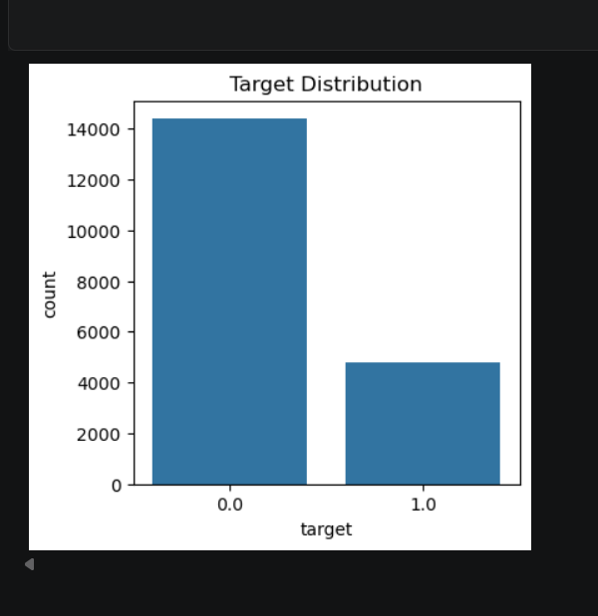
-
Target Variable Distribution
1. The chart shows the distribution of the target variable (job change: 0 or 1).
2. Class 0 (Not looking for job change) has a very high count — around 14,500 employees.
3. Class 1 (Looking for job change) has a much smaller count — around 5,000 employees.
4. This indicates a strong class imbalance in the dataset.
5. Because of this imbalance, techniques like SMOTE were required to balance the data before training the model.

Slide 9
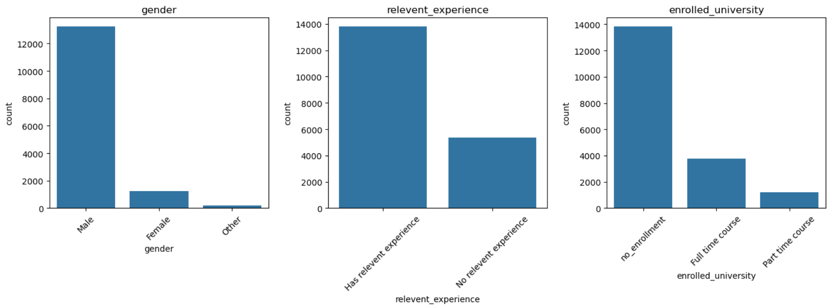
Categorical Feature Distribution 1. Gender Distribution 2.Relevant Experience 3. Enrolled University Status .Majority of employees are Male (highest bar). . Most employees have relevant experience (very tall bar). . Majority of employees have no university enrollment. . Female employees are significantly fewer. . Employees with no relevant experience are much fewer. . A smaller portion is enrolled in full‑time courses. . Other category is almost negligible. . Shows that relevant experience is common in this dataset. . Part‑time course enrollment is the least. . Indicates dataset is gender‑imbalanced. . Suggests most employees are not currently pursuing- - formal education.

Slide 10
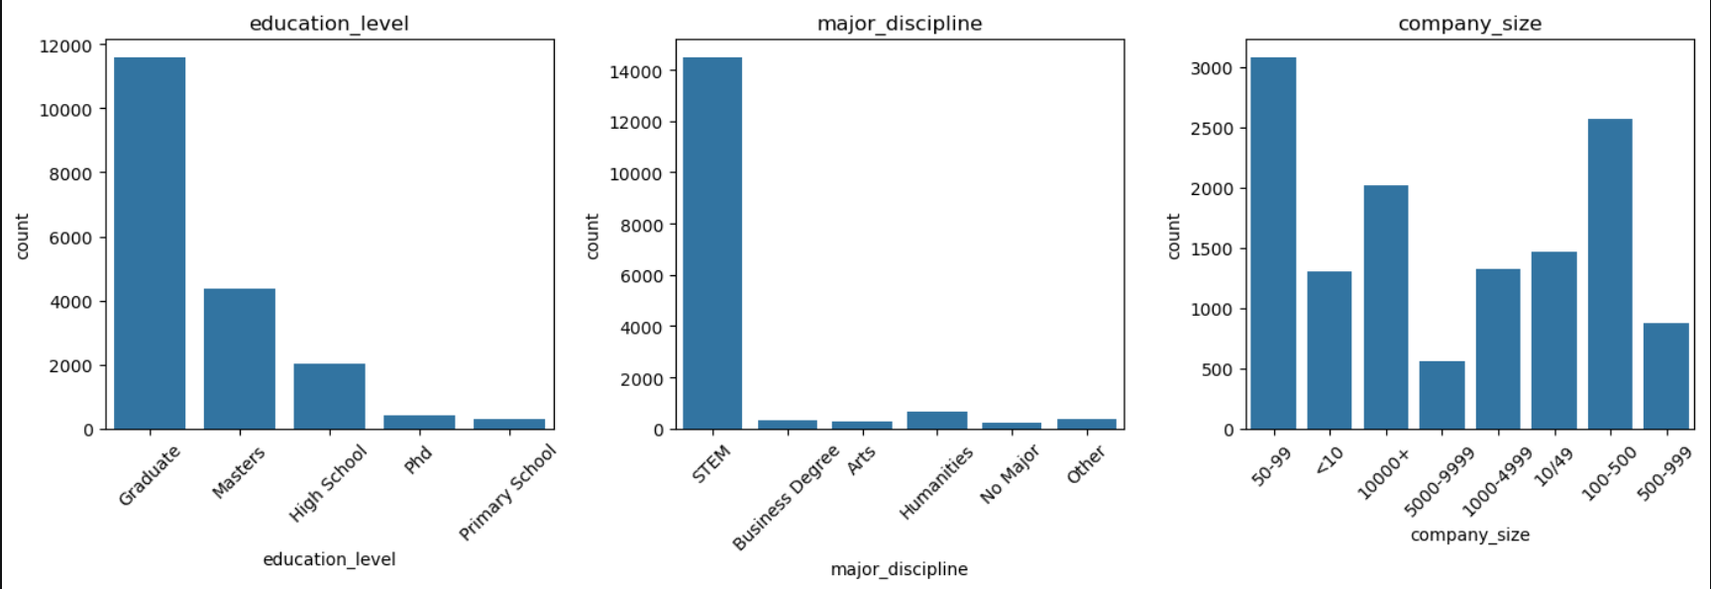
Categorical Feature Distribution 1. Education Level Distribution 2. Major Discipline Distribution 3. Company Size Distribution . Most employees are Graduates (highest bar). . STEM is the overwhelmingly dominant discipline . STEM is the overwhelmingly dominant discipline. . A significant number hold Masters degrees. . Other fields like Business, Arts, Humanities, and- . Highest count is in 50–99 employees category. - No Major have very low counts . High School and PhD categories are much smaller. . Shows that the dataset mainly consists of techni- . 100–500 and 10000+ also have significant repre- - cal backgrounds. -sentation. . Primary School has the lowest count. . Smaller companies (<10, 10–49) and mid‑range -companies (500–999, 1000–4999) have moderate counts. . Indicates that the dataset is dominated by well‑ . Indicates diverse company size distribution in the dataset. - educated professionals

Slide 11
Transition to Target-Based Comparison
After Overview of Categorical Features

Slide 12
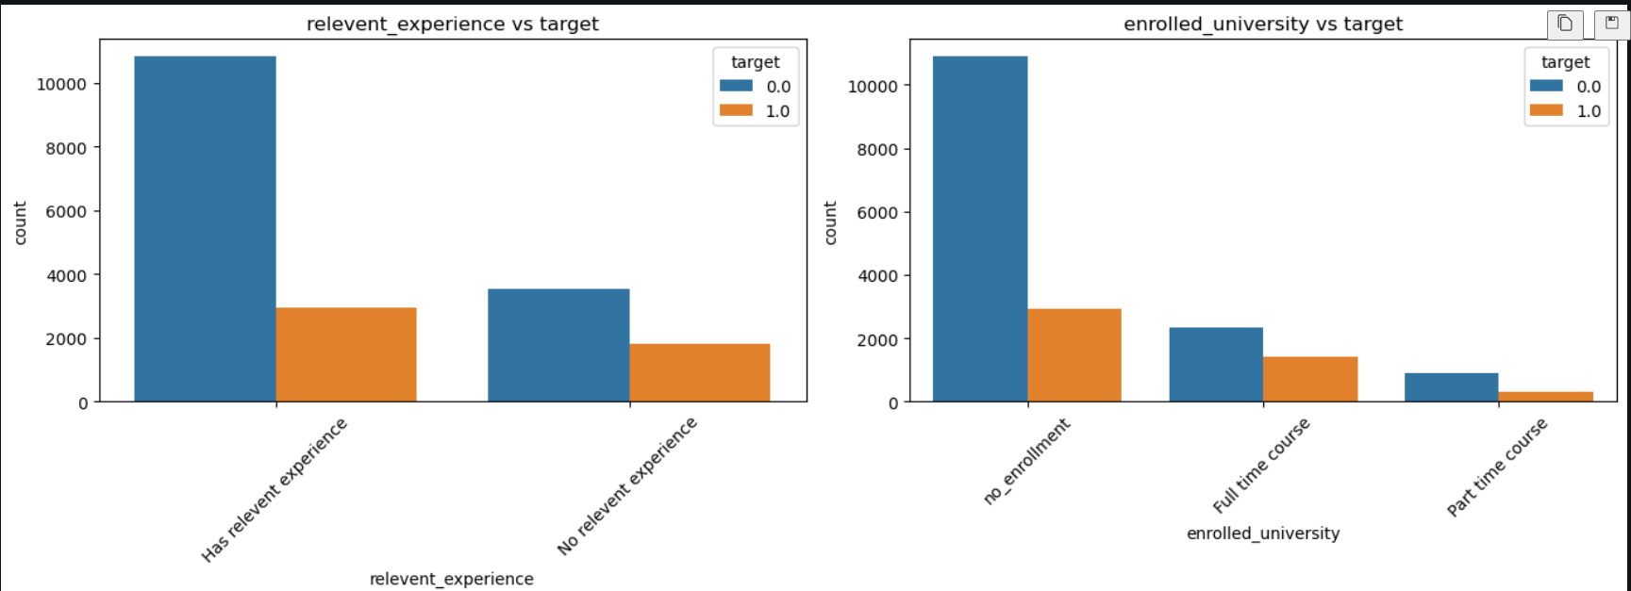
1. Relevant Experience vs Target 2. University Enrollment vs Target . Employees with relevant experience mostly fall under target = 0 (not look- . Majority of employees with no university enrollment belong to target = 0. - ing for job change). . A smaller portion with relevant experience belong to target = 1 (likely to- . Employees enrolled in full‑time courses show a slightly higher tendency toward - change job). - target = 1. . Employees with no relevant experience show a higher proportion of job‑ . Part‑time course enrollment also shows mixed distribution but mostly target = 0 - change intention compared to those with experience. . This indicates that lack of relevant experience increases the probability . This suggests that employees pursuing education (full‑time or part‑time) may of job change. - be more open to job change.

Slide 13
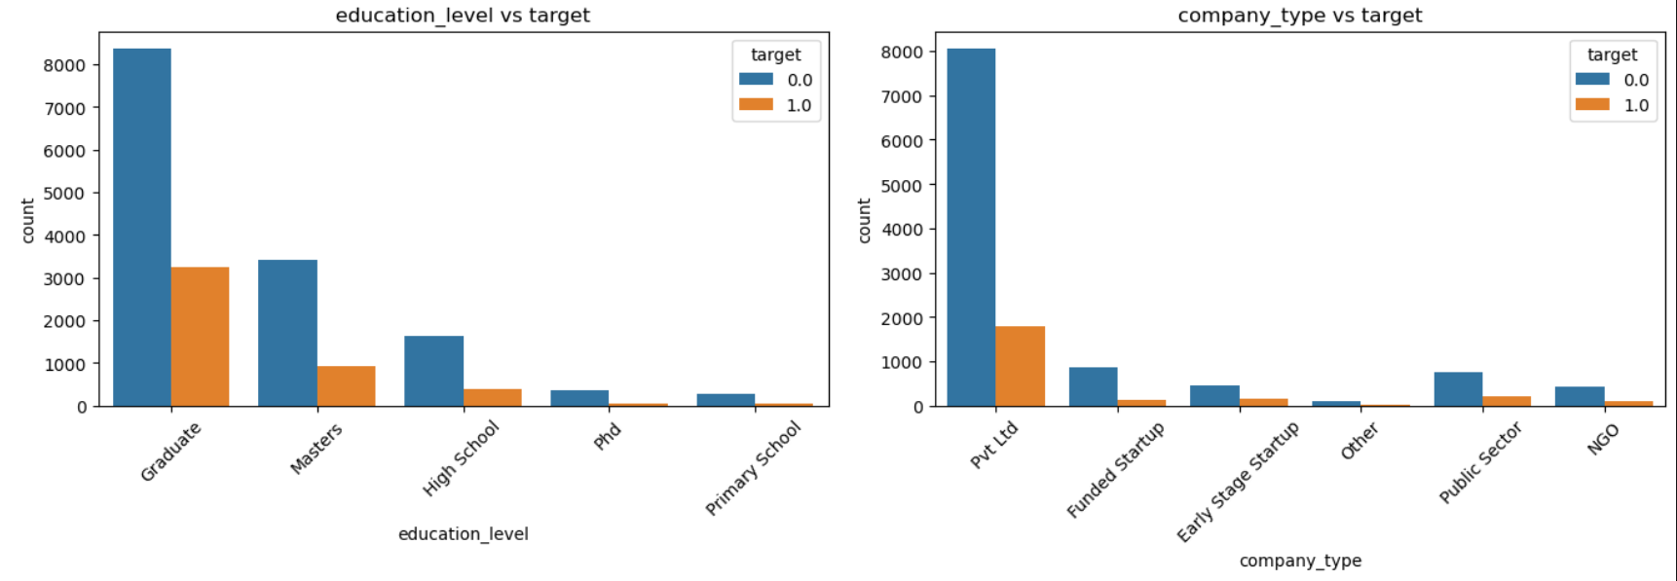
3. Education Level vs Target 4. Company Type vs Target . Most employees are Graduates, followed by Masters. . Majority of employees work in Pvt Ltd companies. . Across all education levels, target = 0 (not looking for job change) is sig- . Other company types like Funded Startup, Early Stage Startup, Public Sector, - nificantly higher than target = 1. - NGO, and Other have much smaller counts. . Higher education levels (Masters, PhD) still show lower job‑change int- . In every company type, target = 0 is higher than target = 1, showing low jod- -ention - change intention overall. . Indicates that education level does not strongly drive job‑change beh- . Slightly higher job‑change tendency appears in startups, but still lower than ta- -avior — most groups remain stable. -rget 0.

Slide 14
Numerical features distribution

Slide 15
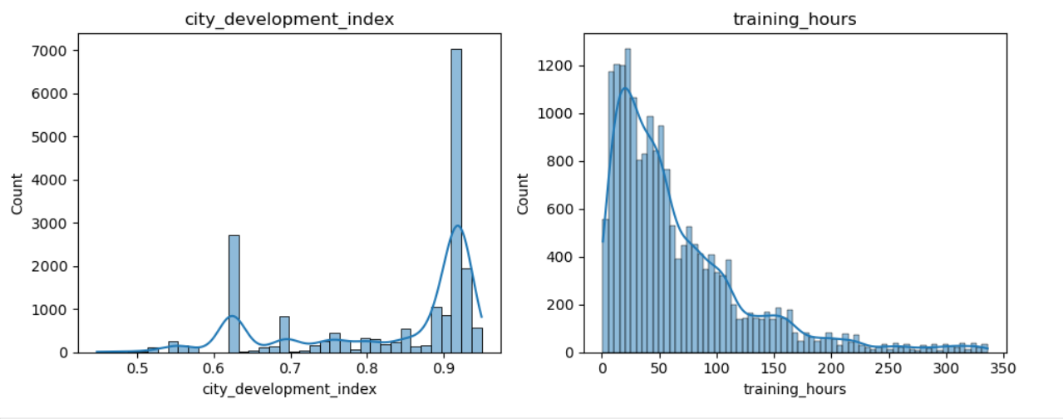
Numerical features distribution 1. City Development Index 2. Training Hours . The histogram shows the spread of city development index values rang- . The distribution of training hours is right‑skewed. -ing roughly from 0.45 to 0.95. . Two major peaks are visible — one around 0.6 and another near 0.9. . Most employees have completed less than 100 hours of training. . This indicates that employees mostly come from moderately developed . Very few employees have training hours above 200–300. and highly developed cities. . The distribution is not uniform, showing clear clustering in specific dev- . This suggests that training participation is generally low, with only a small gr- elopment ranges. -oup investing heavily in training.

Slide 16
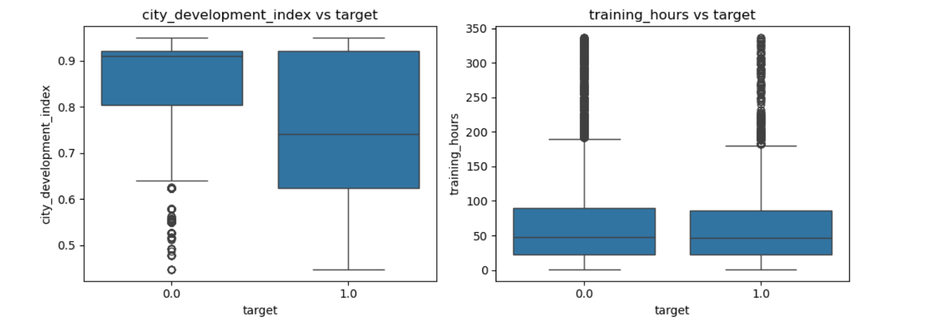
Comparison of Numerical Features with Target Variable 1. City Development Index vs Target 2. Training Hours vs Target . The box plot compares city development index values for employees who . Training hours for both target groups show a similar median around 50 hours. are not looking for a job change (target = 0) and those who are looking for a job change (target = 1). . Both groups have values mostly between 0.5 and 0.95, but target = 0 shows . The distribution is wide, ranging from 0 to 350 hours, with many outliers above a slightly higher median. 200 . There are several lower outliers for target = 0, indicating some employees . Both groups have similar patterns, suggesting that training hours do not from less developed cities. strongly differentiate job‑change behavior. . Overall, employees from more developed cities tend to be more stable, but . High training hours appear in both categories, indicating mixed motivation levels. the difference is not very large.

Slide 17
Preprocessing setup
1. Feature & Target Separation
The dataset contains an ID column (enrollee_id) and the target column (target).
These columns are removed from the feature matrix X, while target is stored separately in y.
2. Identifying Feature Types
Numerical features are explicitly defined: city_development_index, training_hours
All remaining columns are treated as categorical features.
3. Purpose of This Step
Helps in applying appropriate preprocessing techniques:
Scaling for numerical features
Encoding for categorical features
Ensures the model receives clean, structured input.

Slide 18
Preprocessing Pipeline
1. Numerical Feature Processing
A separate pipeline is created for numerical columns:
Median Imputation: Missing numeric values are filled using the median, which is robust against outliers.
Standard Scaling: Numerical features are scaled using StandardScaler to normalize their range and improve model performance.
2. Categorical Feature Processing
A dedicated pipeline handles categorical columns:
Most Frequent Imputation: Missing categorical values are replaced with the most frequent category.
One‑Hot Encoding: Converts categorical values into binary vectors. handle_unknown='ignore' ensures unseen categories during prediction do not break the model.
3. ColumnTransformer Integration
Both pipelines are combined using ColumnTransformer.
Numerical and categorical transformations are applied simultaneously and correctly mapped to their respective columns.
Ensures a clean, consistent preprocessing workflow before model training.

Slide 19
Train–Validation Split
Train–Validation Split (80/20)
The dataset is divided into 80% training data and 20% validation data using train_test_split.
Stratification is applied on the target variable to ensure both sets maintain the same class distribution.
A fixed random_state=42 is used to make the split reproducible.
Final shapes:
Training set: 15,326 samples, 12 features
Validation set: 3,832 samples, 12 features
This step ensures that the model is trained on a large portion of data while still having a separate set for unbiased evaluation.

Slide 20
Class Imbalance Check
Class Distribution in Training & Validation Sets
The class counts for both training and validation sets are printed using value_counts().
Training Set:
Class 0.0 → 11,504 samples
Class 1.0 → 3,822 samples
Validation Set:
Class 0.0 → 2,877 samples
Class 1.0 → 955 samples
Key Insight
Both sets show a significant class imbalance, with class 0.0 being much more frequent than class 1.0.
This imbalance can negatively affect model performance, especially recall for minority class.
Therefore, techniques like SMOTE or class‑weight adjustments are needed to balance the dataset before training.

Slide 21
Model Training & Evaluation Function
1. Unified Training Pipeline
A custom function evaluate_model() is created to streamline model training and evaluation. It builds a complete pipeline consisting of:
Preprocessing (numeric scaling + categorical encoding)
SMOTE (to balance classes)
Classifier (model passed as input)
This ensures consistent preprocessing and balanced training for every model tested.
2. Model Fitting
The pipeline is trained on X_train and y_train.
SMOTE is applied inside the pipeline, preventing data leakage and ensuring proper oversampling only on training data.
3. Predictions & Probabilities
The model predicts class labels (y_pred) on the validation set.
It also generates probability scores (y_proba) for ROC‑AUC evaluation.
4. Evaluation Metrics
The function prints:
Accuracy
ROC‑AUC Score
Confusion Matrix
Classification Report (precision, recall, F1‑score)
These metrics provide a complete performance overview.

Slide 22
-
5. ROC Curve Visualization
A ROC curve is plotted using RocCurveDisplay.
Helps visualize model performance across different thresholds.
6. Return Values
The function returns:
The trained pipeline
Accuracy
ROC‑AUC score
This makes it easy to store and compare multiple models.

Slide 23
Models Used
1. Logistic Regression
Simple baseline model
Good for linear relationships
Helps compare performance with advanced models
2. Random Forest Classifier
Ensemble of decision trees
Handles non‑linear patterns well
Works effectively with mixed data types
3. XGBoost Classifier
Gradient boosting algorithm
Excellent for tabular data
Handles missing values internally
High performance in many ML competitions
4. LightGBM Classifier (Best Model)
Fast and efficient boosting algorithm
Works well with large datasets
Handles categorical features effectively
Achieved the highest ROC‑AUC score

Slide 24
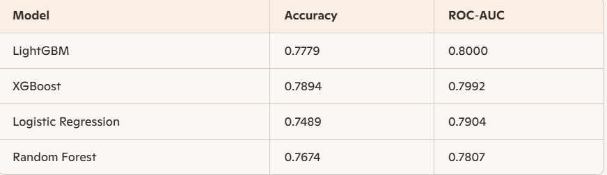
Model Performance Comparison
Comparison of Machine Learning Models
A results table is created to compare four different machine learning models based on Accuracy and ROC‑AUC:

Slide 25
Feature Importance (Random Forest) – Results Included
How Feature Importance Was Extracted
A Random Forest model was trained using a preprocessing pipeline.
Because categorical features are one‑hot encoded, a separate pipeline (without SMOTE) was fitted to extract the transformed feature names.
Numeric features remain unchanged; categorical features expand into multiple binary columns.
These names were combined with Random Forest’s feature_importances_ to generate a complete importance ranking.

Slide 26
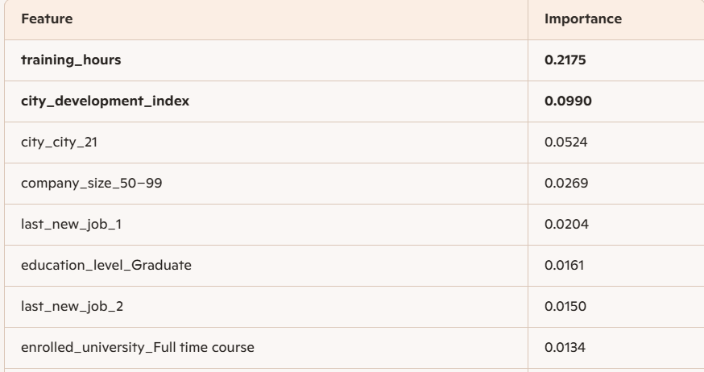
Top Feature Importance Results

Slide 27
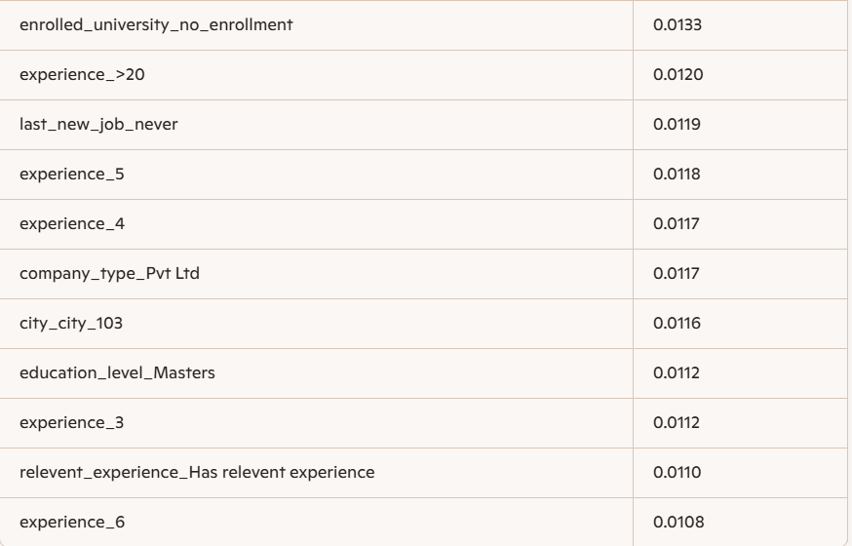
-

Slide 28
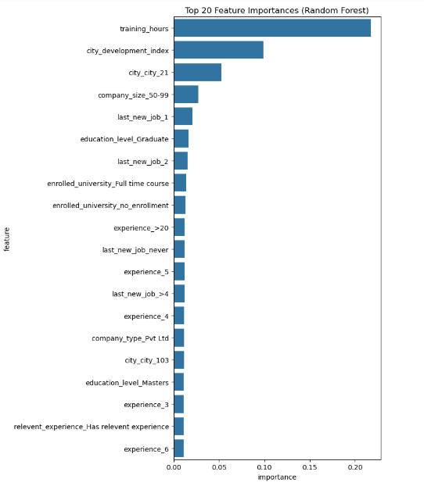
Top 20 Feature Importances Understanding the Feature Importance Chart This horizontal bar chart displays the top 20 most influential features identified by the Random Forest model. Each bar represents a feature, and its length indicates how strongly that feature contributes to predicting whether an employee will change jobs. Key Observations .training_hours is the most important feature, showing the strongest influence on job‑change prediction. .city_development_index is the second most impactful feature, indicating that employees from more developed cities show distinct behavior. .Several one‑hot encoded city categories (like city_city_21, city_city_103) also contribute significantly. .Company size, last new job, and education level features appear prominently, showing their relevance in employee decision patterns. .Experience‑related features (e.g., experience_>20, experience_5, experience_4) also play a meaningful role What This Means .The model relies heavily on training activity, city development, and job history to make predictions. .Categorical variables, once one‑hot encoded, provide rich signals that help the model differentiate between employees likely to change jobs and those who are not.

Slide 29
Final Model Training on Full Dataset (LightGBM)
1. Full Dataset Preparation
The complete training dataset is used by recreating X_full (all features except ID and target) and y_full (target column).
This ensures the final model learns from 100% of available labeled data, improving generalization.
2. Best Model Selection
Based on earlier model comparison, LightGBM was chosen as the best-performing model.
It showed the highest ROC‑AUC and strong accuracy, making it ideal for final deployment.
3. Final Pipeline Construction
The final pipeline includes:
Preprocessor
Numeric: median imputation + scaling
Categorical: frequent imputation + one‑hot encoding
SMOTE
Balances the dataset by oversampling minority class

Slide 30
-
LightGBM Classifier
Tuned with parameters:
n_estimators = 300
learning_rate = 0.05
subsample = 0.8
colsample_bytree = 0.8
random_state = 42
4. Model Training
The pipeline is fitted on the entire dataset (28,762 samples).
LightGBM logs confirm:
Balanced positive & negative samples after SMOTE
159 features used (after one‑hot encoding)
Efficient multi-threading enabled
Total bins ≈ 13,789
The model successfully learns patterns from the fully preprocessed and balanced data.

Slide 31
Final Predictions on Test Data
1. Preparing Test Features
The test dataset contains an ID column (enrollee_id) which is removed before prediction.
Remaining columns form X_test, which is passed through the final trained pipeline.
2. Generating Predictions
The final LightGBM pipeline (final_clf) predicts:
Class labels → test_pred
Probabilities → test_proba (optional, useful for ranking or threshold tuning)
3. Creating Submission File
A submission DataFrame is created with:
enrollee_id
target (predicted class)
This matches the required format for Kaggle/competition submissions.
4. Output (Head of Submission File)

Slide 32
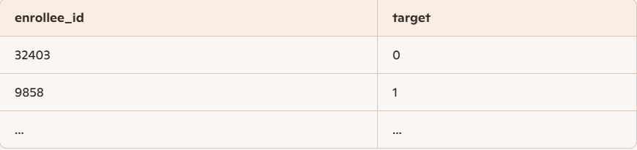
The first few rows look like:

Slide 33
Saving Final Predictions & Model Export
1. Exporting Test Predictions
The final predictions generated on the test dataset are saved into a CSV file: test_predictions.csv
This file contains two columns:
enrollee_id
target (model‑predicted class)
This CSV is ready for submission or deployment.
2. Saving the Trained Model
The complete pipeline (preprocessing + SMOTE + LightGBM) is saved as a .pkl file using joblib.dump.
File name: best_model_lgbm.pkl
This allows the model to be reused later without retraining — ideal for production or API deployment.
3. Why This Step Matters
Ensures reproducibility and portability of the final model.
Makes it easy to load the trained model and generate predictions on new incoming data.
Keeps your workflow clean and professional, matching industry standards.

Slide 34
Saving Predictions & Exporting Final Model
1. Creating the Models Folder
A new directory named models/ is created inside the project using: os.makedirs("models", exist_ok=True)
exist_ok=True ensures the code does not throw an error if the folder already exists.
2. Saving Test Predictions
The final predictions generated on the test dataset are saved as: models/test_predictions.csv
This CSV contains:
enrollee_id
target (model‑predicted class)
3. Exporting the Final Trained Model
The complete pipeline (preprocessing + SMOTE + LightGBM) is saved using joblib: models/best_model_lgbm.pkl
This allows the model to be reused later without retraining — ideal for deployment or API integration.
4. Confirmation Message
After saving both files, the script prints: “Saved successfully!”
This confirms that the export process completed without errors.

Slide 35
Thank You!
Thank You for Your Time!

